Slide 1
This slide is hidden.
Insert the starting slides after this slide

Slide 2


Welcome to St Patrick’s
29th Sunday in Ordinary Time Year A
You have entered a
SACRED SPACE
– a SACRED TIME...
Please ensure all mobile phones
are switched off.
Please be respectfully quiet
as we prepare for our celebration.
Notes:
Saturday 5.30PM First Sunday of Advent
23rd Sunday in Ord Time
23rd Sunday in Ord Time

Slide 3
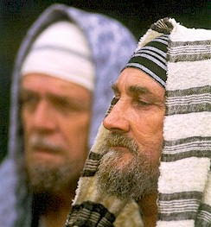
The Pharisees went away to work out between them how to trap Jesus …
Notes:
23rd Sunday in Ord Time
23rd Sunday in Ord Time

Slide 4
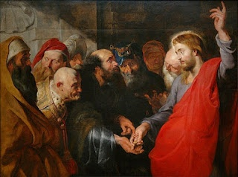
'Master, we know that you are an honest man …
tell us your opinion then…
Is it permissible to pay taxes to Caesar or not?'
Notes:
23rd Sunday in Ord Time
23rd Sunday in Ord Time

Slide 5
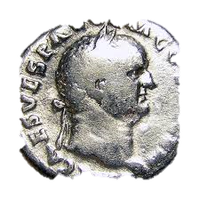
‘Let me see the money you pay the tax with… whose head is this? Whose name? …
…then give back to Caesar what belongs to Caesar - and to God what belongs to God.’
‘who do you say I am?’
Notes:
23rd Sunday in Ord Time
23rd Sunday in Ord Time

Slide 6

How and what will you give to God during the coming week?
Notes:
23rd Sunday in Ord Time
23rd Sunday in Ord Time

Slide 7
Please Stand

Slide 8
This slide is hidden.
Insert the Entrance Hymn after this slide

Slide 9
The power of your love
Lord I come to you
Let my heart be changed, renewed
Flowing from the grace
That I found in you

Slide 10
And Lord I've come to know
The weaknesses I see in me
Will be stripped away
By the power of your love

Slide 11
Hold me close, let your love surround me
Bring me near, draw me to your side
And as I wait, I'll rise up like the eagle
And I will soar with you
Your spirit leads me on,
In the power of your love

Slide 12
Lord, unveil my eyes
Let me see you face to face
The knowledge of your love
As you live in me

Slide 13
Lord renew my mind
As your will unfolds in my life
In living everyday
By the power of your love

Slide 14
Hold me close, let your love surround me
Bring me near, draw me to your side
And as I wait, I'll rise up like the eagle
And I will soar with you
Your spirit leads me on,
In the power of your love

Slide 15
And I will soar with you
Your spirit leads me on
In the power of your love

Slide 17
Confiteor
I confess to almighty God
And to you, my brothers and sisters,
That I have greatly sinned
In my thoughts and in my words

Slide 18
In what I have done
And in what I have failed to do,
Through my fault,
Through my fault,
Through my most grievous fault;

Slide 19
Therefore I ask blessed Mary ever-Virgin,
All the Angels and Saints,
And you, my brothers and sisters,
To pray for me to the Lord our God.

Slide 21
Kyrie eleison
Kyrie eleison (2)
Christe eleison (2)
Kyrie eleison (2)

Slide 23
Gloria
Glory to God in the highest,
and on earth peace to people of good will.
We praise you, we bless you,
we adore you, we glorify you,

Slide 24
We give you thanks for your great glory,
Lord, God heavenly king,
O God, almighty father

Slide 25
Glory to God in the highest,
and on earth peace to people of good will.

Slide 26
Lord Jesus Christ, Only Begotten Son,
Lord God, Lamb of God, Son of the Father,
you take away the sins of the world,
have mercy on us;

Slide 27
you take away the sins of the world, receive our prayer;
you are seated at the right hand of the Father,
have mercy on us.

Slide 28
Glory to God in the highest,
and on earth peace to people of good will.

Slide 29
For you alone are the Holy One,
you alone are the Lord,
you alone are the Most High, Jesus Christ,
with the Holy Spirit,
in the glory of God the Father.

Slide 30
Glory to God in the highest,
and on earth peace to people of good will.
Amen.

Slide 32
Responsorial Psalm
Give the Lord glory and honour.

Slide 34
Alleluia
Alleluia, alleluia,
alleluia, alleluia

Slide 36
Apostles Creed
I believe in God,
the Father almighty,
Creator of heaven and earth,
and in Jesus Christ, his only Son, our Lord,
(At the words that follow, up to and including the Virgin Mary, all bow.)

Slide 37
who was conceived by the Holy Spirit,
born of the Virgin Mary,
suffered under Pontius Pilate,
was crucified, died and was buried;
he descended into hell;

Slide 38
on the third day he rose again from the dead;
he ascended into heaven,
and is seated at the right hand of God the Father almighty;

Slide 39
from there he will come to judge the living and the dead.
I believe in the Holy Spirit,
the holy catholic Church,

Slide 40
the communion of saints,
the forgiveness of sins,
the resurrection of the body,
and life everlasting.
Amen.

Slide 42
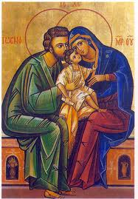
Jesus, Mary and Joseph,
in you we contemplate
the splendor of true love,
to you we turn with trust.
Holy Family of Nazareth,
grant that our families too
may be places of communion and prayer,
authentic schools of the Gospel
and small domestic Churches.

Slide 43
Holy Family of Nazareth, may families never again
experience violence, rejection and division:
may all who have been hurt or scandalized
find ready comfort and healing.
Holy Family of Nazareth, may the Synod of Bishops on the Family make us once more mindful of the sacredness of the family, and its beauty in God's plan.
Mary, Queen of the Family - Pray for us

Slide 44
First Collection
This collection goes to the Bishop
for the support of the Diocese.
Thank you for your contribution

Slide 46
This slide is hidden.
Insert the Offertory Hymn after this slide.

Slide 47

Lord, I offer my life
All that I am, all that I have
I lay them down before you, oh Lord
All my regrets, all my acclaims
The joy and the pain,
I'm making them yours

Slide 48
Lord, I offer my life to you
Everything I've been through
Use it for your glory

Slide 49
Lord I offer my days to you
Lifting my praise to you
As a pleasing sacrifice
Lord I offer you my life

Slide 50
Things in the past, things yet unseen
Wishes and dreams
that are yet to come true
All of my hopes, all of my plans
My heart and my hands are lifted to you

Slide 51
Lord, I offer my life to you
Everything I've been through
Use it for your glory

Slide 52
Lord I offer my days to you
Lifting my praise to you
As a pleasing sacrifice
Lord I offer you my life

Slide 53
What can we give that you have not given?
And what do we have
That is not already yours?
All we possess are these lives we're living
That's what we give to you, Lord

Slide 54
Lord, I offer my life to you
Everything I've been through
Use it for your glory

Slide 55
Lord I offer my days to you
Lifting my praise to you
As a pleasing sacrifice
Lord I offer you my life

Slide 57
Priest: Pray my brothers and sisters,
that my sacrifice and yours may be
acceptable to God, the almighty Father.
All: May the Lord accept the sacrifice
at your hands for the praise and glory of his name, for our good and the good of all his holy Church.

Slide 58
Priest: The Lord be with you.
All: And with your spirit.
Priest: Lift up your hearts.
All: We lift them up to the Lord.

Slide 59
Priest: Let us give thanks to the
Lord our God.
All: It is right and just.

Slide 61
Holy
Holy, Holy, Holy Lord God of hosts,
Heaven and earth are full of your glory. Hosanna in the highest
Blessed is he who comes
in the name of Lord,
Hosanna in the highest.

Slide 63
Memorial acclamation
Save us saviour of the world,
For by your cross and resurrection,
You have set us free

Slide 64
Memorial acclamation
When we eat this bread
And drink this cup
We proclaim your death O Lord
Until you come again

Slide 65
Memorial acclamation
We proclaim your death O Lord
And profess your resurrection
Until you come again

Slide 67
Amen
Amen, amen, amen, amen.
Amen, amen, amen, amen.

Slide 69
Priest: The Lord be with you.
All: And with your spirit

Slide 71
Peace
May the peace of the Lord be with you
With your friends and your family too
Let it be, let it grow
And everywhere you go
May the peace of the Lord follow you

Slide 72
Lamb of God
Lamb of God, lamb of God
You take away the sins of the world
Have mercy on us, lamb of God

Slide 73
Lamb of God, lamb of God
You take away the sins of the world
Have mercy on us, lamb of God

Slide 74
Lamb of God, lamb of God
You take away the sins of the world
Grant us, grant us peace

Slide 76
Priest: Behold the Lamb of God, behold him
who takes away the sins of the world.
Blessed are those called to the supper of the Lamb.
All: Lord, I am not worthy
that you should enter under my roof,
but only say the word
and my soul shall be healed.

Slide 77
This slide is hidden.
Insert the Communion Hymns after this slide.

Slide 78
In love for me
This is my body broken for you
Bringing you wholeness making you free
Take it and eat it, and when you do
Do it in love for me

Slide 79
This is my blood poured out for you
Bringing forgiveness, making you free
Take it and drink it, and when you do
Do it in love for me

Slide 80
This is my body broken for you
Bringing you wholeness making you free
Take it and eat it, and when you do
Do it in love for me

Slide 81
This is my blood poured out for you
Bringing forgiveness, making you free
Take it and drink it, and when you do
Do it in love for me
Do it in love for me

Slide 82
Come O Lord
Come, O lord, to my heart today
And stay with me all the day.
Come, O lord, to my heart today
And stay with me all the day.

Slide 83
Your flesh is food and your blood is drink
With these you give to me your life

Slide 84
Come, O lord, to my heart today
And stay with me all the day.
Come, O lord, to my heart today
And stay with me all the day.

Slide 85
This is the bread come down from heaven
Which if a man eats he’ll live forever

Slide 86
Come, O lord, to my heart today
And stay with me all the day.
Come, O lord, to my heart today
And stay with me all the day.

Slide 87
He who takes your flesh and blood
Lives in you and you in Him

Slide 88
Come, O lord, to my heart today
And stay with me all the day.
Come, O lord, to my heart today
And stay with me all the day.

Slide 89
When you give your self to us
you bind us to your self and each other.

Slide 90
Come, O lord, to my heart today
And stay with me all the day.
Come, O lord, to my heart today
And stay with me all the day.

Slide 91
I am the bread of life
I am the bread of life,
He who comes to me shall not hunger,
He who believes in me shall not thirst.
No one can come to me
Unless the Father draw him.

Slide 92
And I will raise him up,
And I will raise him up,
And I will raise him up on the last day.

Slide 93
The bread that I will give
Is my flesh for the life of the world,
And he who eats of this bread,
He shall live for ever,
He shall live for ever.

Slide 94
And I will raise him up,
And I will raise him up,
And I will raise him up on the last day.

Slide 95
Unless you eat of the flesh
Of the Son of Man,
And drink of His blood
And drink of His blood,
You shall not have life within you

Slide 96
And I will raise him up,
And I will raise him up,
And I will raise him up on the last day.

Slide 97
And I will raise him up,
And I will raise him up,
And I will raise him up on the last day.

Slide 98
Ave Maria
Dominus tecum benedicta tu
As I kneel before you
As I bow my head in prayer
Take this day, make it yours
And fill me with your love

Slide 99
Ave Maria, gratia plena
Dominus tecum benedicta tu

Slide 100
All I have I give you,
Every dream and wish are yours.
Mother of Christ, Mother of mine
Present them to my Lord

Slide 101
Ave Maria, gratia plena
Dominus tecum benedicta tu

Slide 102
As I kneel before you,
And I see your smiling face
Every thought, every word,
Is lost in your embrace.

Slide 103
Ave Maria, gratia plena
Dominus tecum benedicta tu
Dominus tecum benedicta tu

Slide 105
Second Collection
What you contribute now
is for the support of our
parish and its mission.
Thank you for your generosity

Slide 106
This slide is hidden.
Insert the Notices for the week after this slide

Slide 107
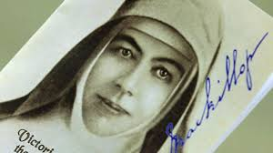

JOSEPHITE ASSOCIATES MEETING
St Michael’s Centre
10.30am
Monday 20th October

Slide 108

RELAY FOR LIFE
Blacktown International Sportspark
  9.30am Saturday 25 October to
  10.00am Sunday 26 October

Slide 109


Loaves and Fishes
would appreciate your help in providing:
Tinned Fish (Tuna/Salmon)
    Tinned Fruit
    Biscuits, Vegemite)
for the needy in our community.
Jean and Betty’s Bus Trip
Rouse Hill Farm House &
Windsor Paddler Wheeler
11 November 2014 - $60.00pp
Notes:
7am - 23rd Sunday in Ord Time
7am - 23rd Sunday in Ord Time

Slide 110

Please take home your bulletin or download it
www.stpatricksparish.org.au
Visit us on Facebook
www.facebook.com/blacktowncatholics

Slide 111
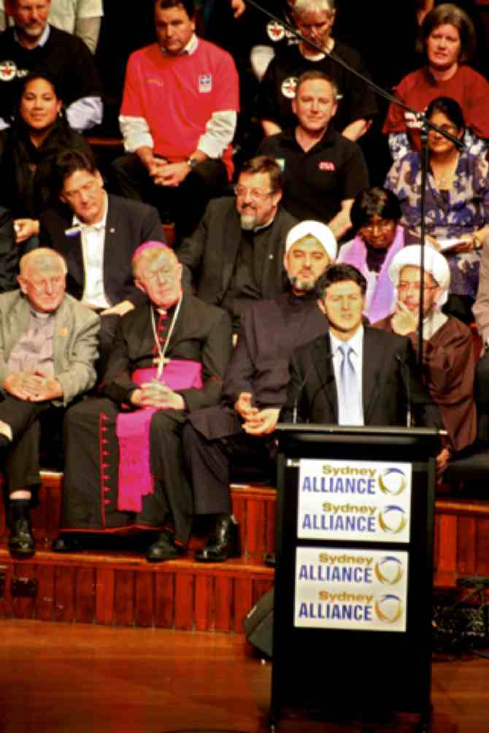
SYDNEY ALLIANCE
in conjunction with the
Diocesan Social Justice Office
invite you to
WESTERN SYDNEY ASSEMBLY!
WED OCT 29th
7pm-8:30pm
PARRAMATTA TOWN HALL
182 Church St, Parramatta
Optional Dinner by donation – Parramatta Mission, 6:00pm-6:30pm,
119 Macquarie Street Parramatta
www.sydneyalliance.org.ay/west

Slide 112
This slide is hidden.
The next slide can be used for videos.
Insert the video into the slide.

Slide 114
Priest: The Lord be with you.
All: And with your spirit.

Slide 116
This slide is hidden.
Insert the Recessional Hymns after this slide.

Slide 117
Shine Jesus Shine
Lord, the Light of Your Love is shining,
In the midst of the darkness shining,
Jesus, Light of the World, shine upon us,
Set us free by the truth You now bring us,
Shine on me. Shine on me.

Slide 118
Shine, Jesus shine,
Fill this land with the Father's glory.
Blaze, Spirit blaze,
Set our hearts on fire.

Slide 119
Flow, river flow,
Flood the nations with grace and mercy.
Send forth Your word,
Lord and let there be light.

Slide 120
Lord I come to Your awesome presence,
From the shadows into Your radiance.
By the blood I may enter Your brightness,
Search me, try me, consume all my darkness.
Shine on me. Shine on me.

Slide 121
Shine, Jesus shine,
Fill this land with the Father's glory.
Blaze, Spirit blaze,
Set our hearts on fire.

Slide 122
Flow, river flow,
Flood the nations with grace and mercy.
Send forth Your word,
Lord and let there be light.

Slide 123
As we gaze on Your kindly brightness.
So our faces display Your likeness.
Ever changing from glory to glory,
Mirrored here may our lives tell Your story.
Shine on me. Shine on me.

Slide 124
Shine, Jesus shine,
Fill this land with the Father's glory.
Blaze, Spirit blaze,
Set our hearts on fire.

Slide 125
Flow, river flow,
Flood the nations with grace and mercy.
Send forth Your word,
Lord and let there be light.

Slide 126
This slide is hidden.
Insert the final slide here.

